Slide 1
How to fail with .NET reflection
Ivan Ivanov
Software Engineer, Reporting team
30.10.2024

Slide 2
- How to fail with .NET reflection? - By having unsafe deserialization! . . .

Slide 3


Slide 4
https://github.com/ivan-h-ivanov/Deserialization-cases

Slide 5
Common fallacies about (custom) deserialization

Slide 6
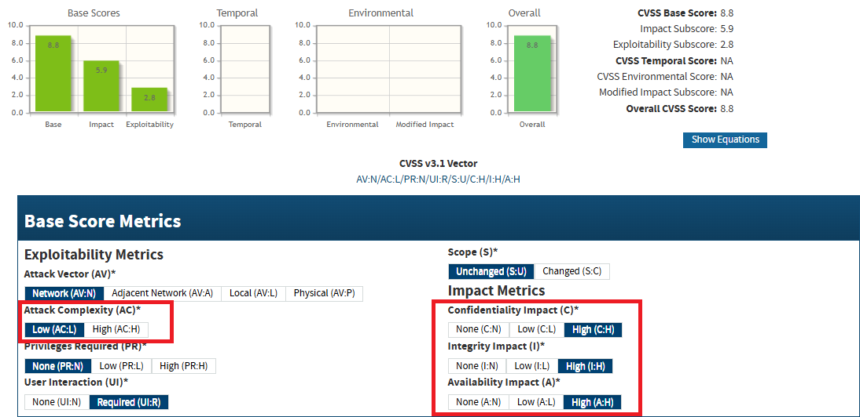
“Is it that bad? It is a single attack type?”

Slide 7
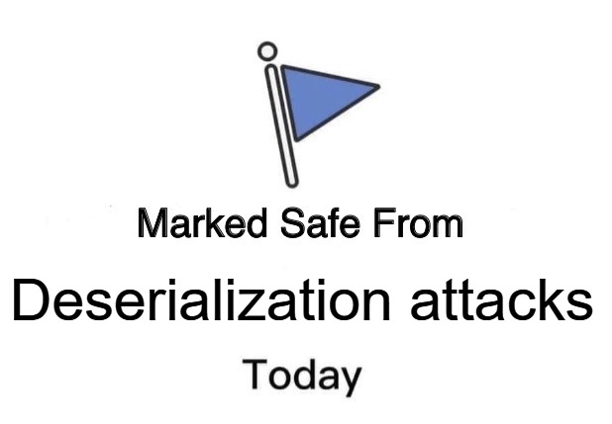
“But I should be fine, I guess…”
“I read that MSDN article: Deserialization Risks…”
Better check this one: OWASP Deserialization Cheat Sheet
“SAST tool is green”

Slide 8
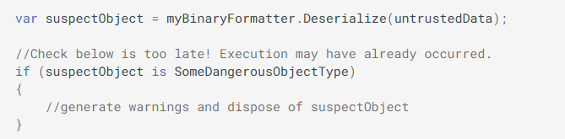
“I can cast it and be safe”
*Unsafe deserialization is the second most evil thing after screenshots of code

Slide 9
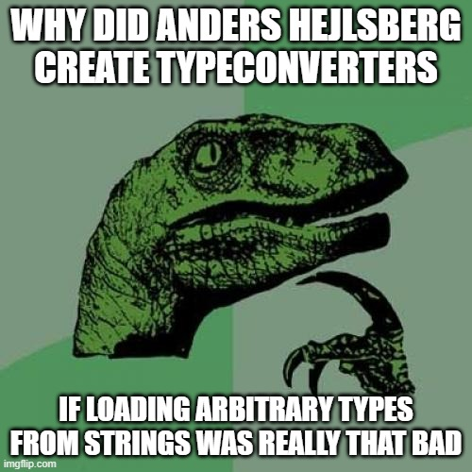
“…I can cast it and be safe”
(Code Demo)

Slide 10

“My AppDomain is my castle”
(Shoutout to Bobi Ivanov)
(Code Demo)

Slide 11
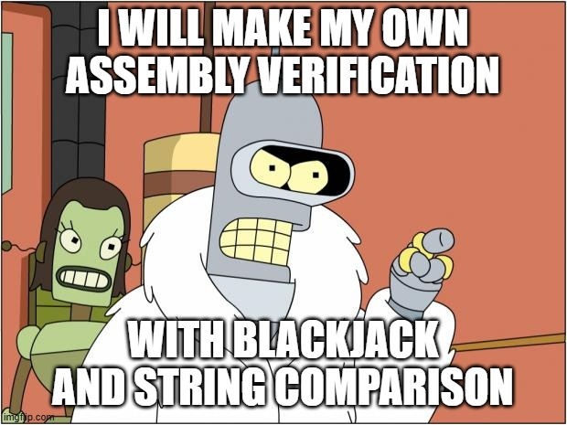
“I will make my own type/assembly verification”
(Code Demo)
Bypassing .NET Serialization Binders

Slide 12
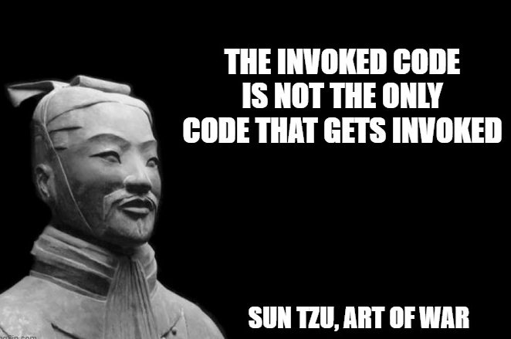
“I read the invoked code. Trust me, bro!”
(Shoutout to Panata)
Module Initializers
(Code Demo)

Slide 13
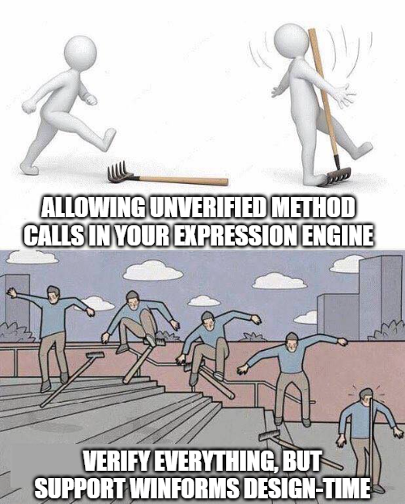
“I have restricted reflection calls? I am safe, right?
(Code Demo)

Slide 14
Demos

Slide 15
Ok, now what?

Slide 16
Allowlist vs Denylist
Allowlists:
Align with “Secure by default” principle
Require less maintenance
Are more beginner friendly to new developers on the team

Slide 17
Read list
Checklist for Dangerous APIs (kudos to Todor Mitskovski)
OWASP principles of security
OWASP input validation checklist
YSOSERIAL.NET
Code-white

Slide 18


